Slide 1
Design thinking and innovation
Presented by
Ch Hemalatha (23KD1A0224)
G poornima (23KD1A0235)
Ch prasad(23KD1A0221)
B venu (23KD1A0209)

Slide 2
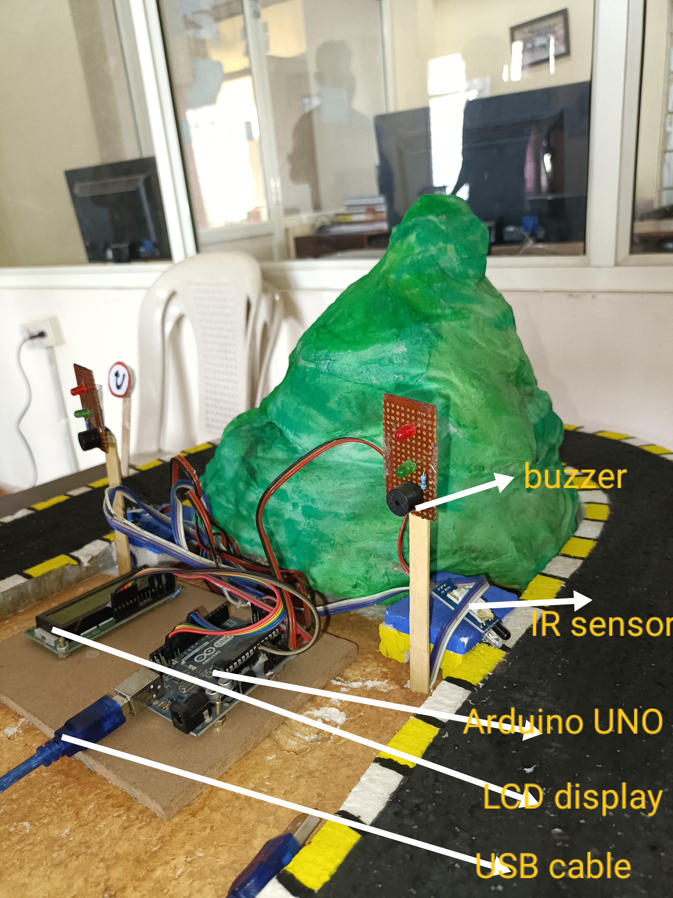
Road accident prevention in hilly areas
DESIGN THINKING AND INNOVATION
UNDER THE GUIDANce of
Mr.b.ram varaprasad (ph.d)
Assistant professor,
Department of EEE,
Liet(A).

Slide 3


What is meant by design thinking?

Slide 4

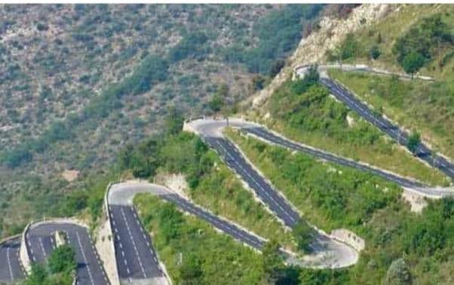
Problem statement
Road Design Challenges
Weather and Visibility Issues
Natural Hazards
Human Factors
Infrastructure problem
Emergency Response Challenges

Slide 5

Empathy
Drive with care
Slow down on curves
Use headlights in fog
Give space to others
Avoid overtaking on bends
Check brakes regularity
Stay alert,avoid distractions
Respect road signs
Use horn gently at turns

Slide 6
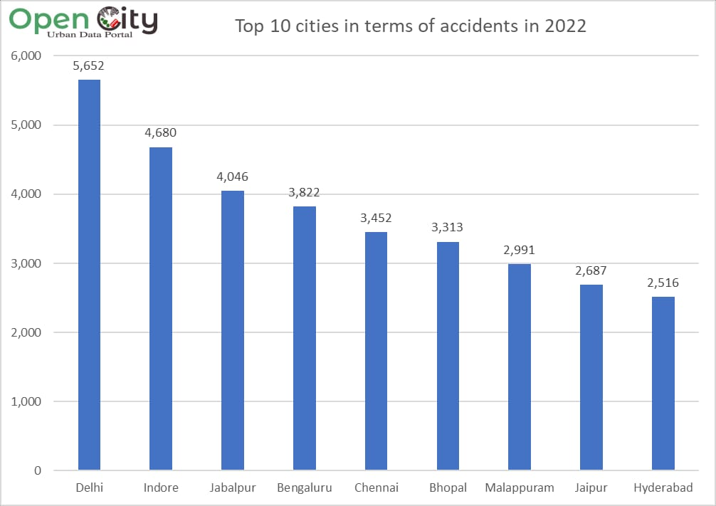
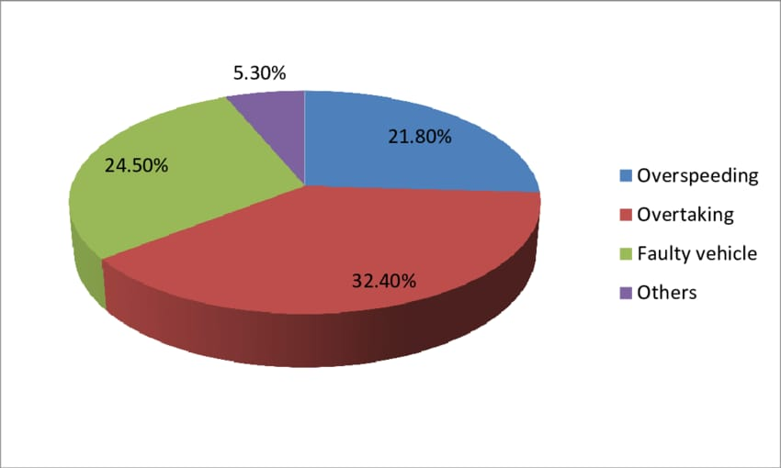
Case study

Slide 7

Survey questions ?
1. How often do you drive in hilly areas? 2. Have you ever had an accident in a hilly area? 3. What do you think causes most accidents in hilly areas? 4. Do you think road safety measures are adequate in hilly areas? 5. What would make you feel safer driving in hilly areas?

Slide 8



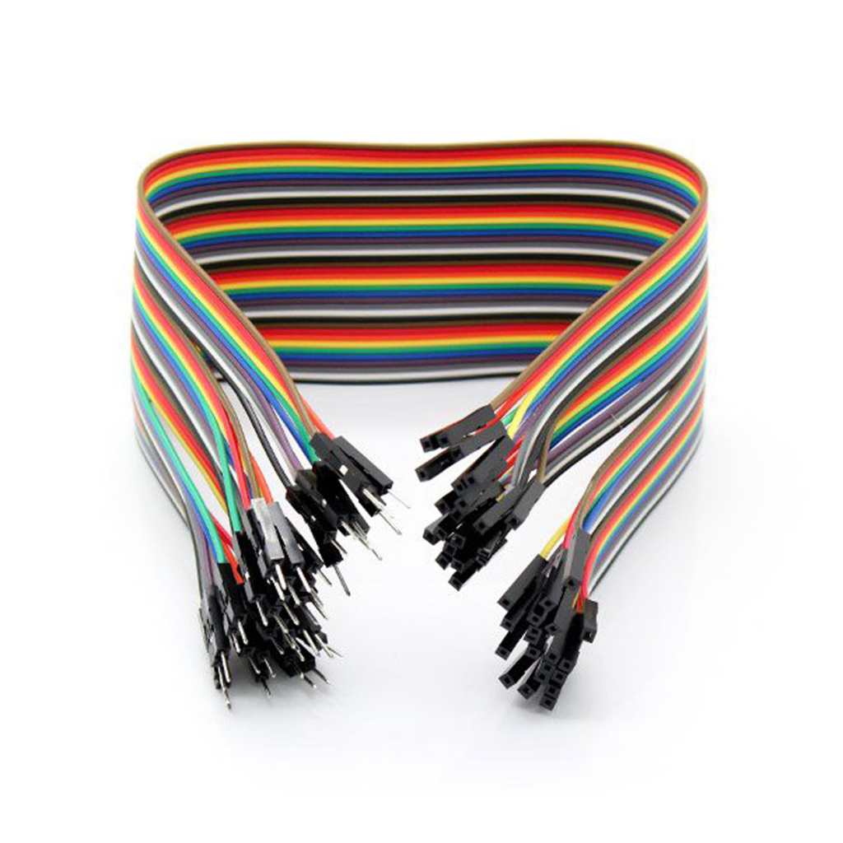


Components
IR sensors
USB cable
Arduino UNO
LCD display
Jumper wires
Buzzer

Slide 9
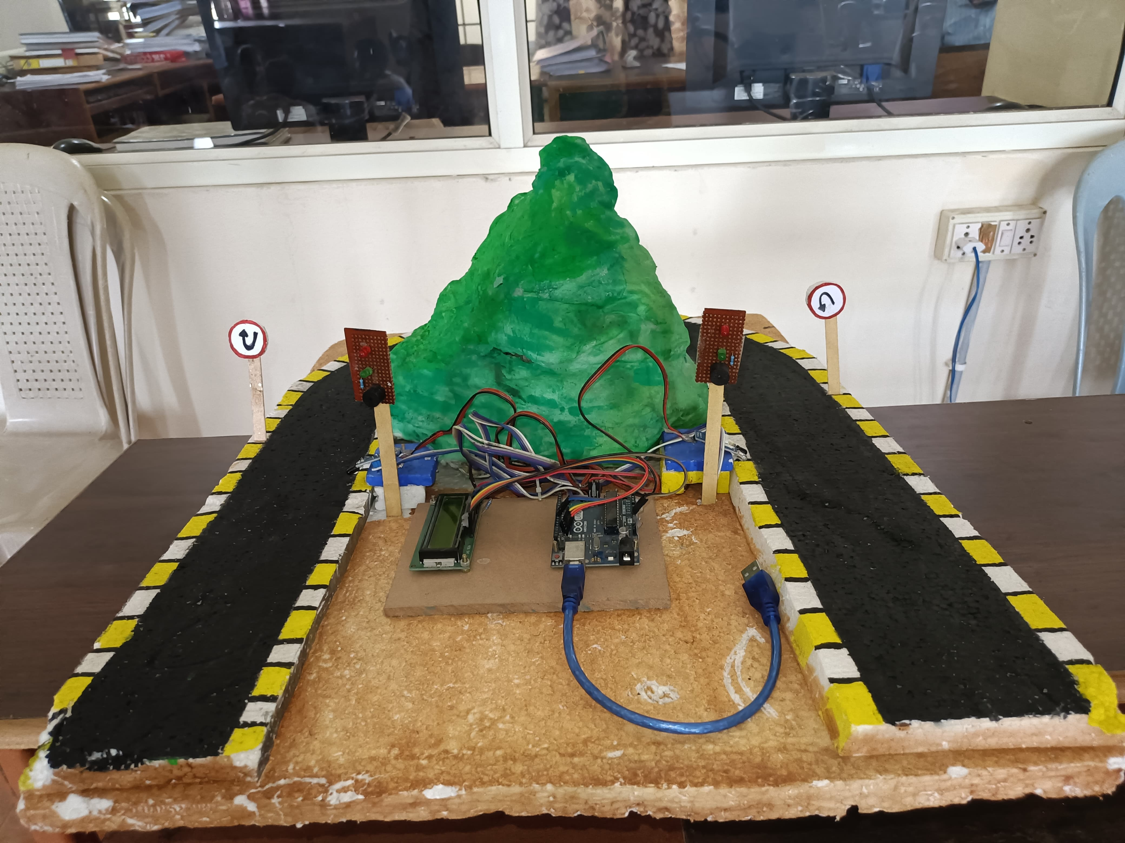
Working principle
STEPS
VEHICLE DETECTOR
SHOWS INFORMATIVE INDICATORS
PREVENT ACCIDENTS

Slide 10
applications
Warning Signboards
Speed control measures
Proper road lighting
Guardrails and barriers
Mirror placement at blind turns
Regular road maintenance
Weather monitoring system
Driver awareness campaign
Emergency call boxes
Enforcement of whole fitness checks

Slide 11
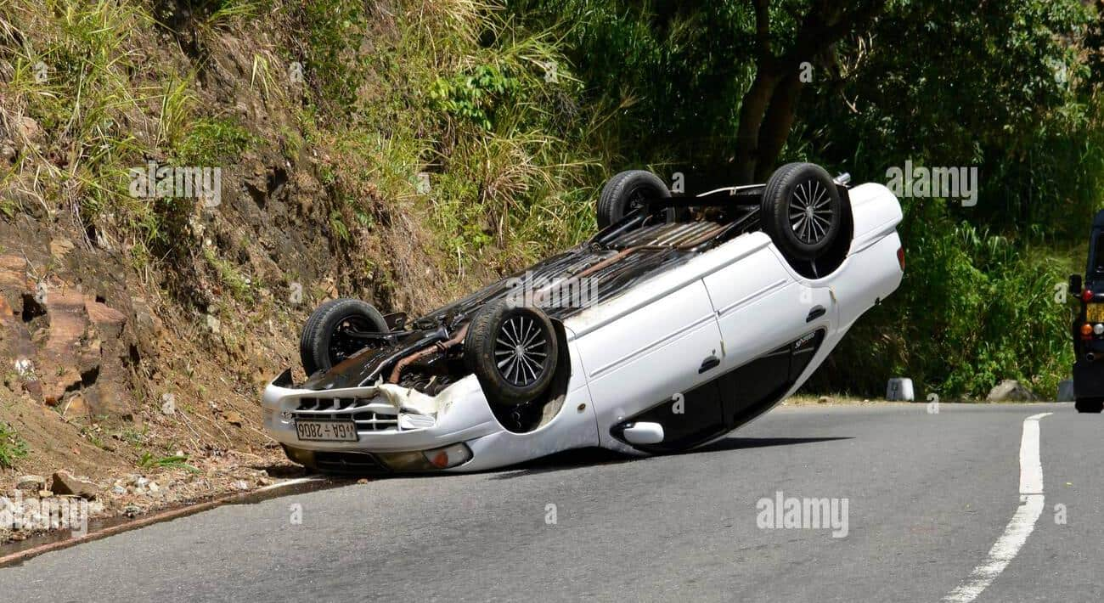
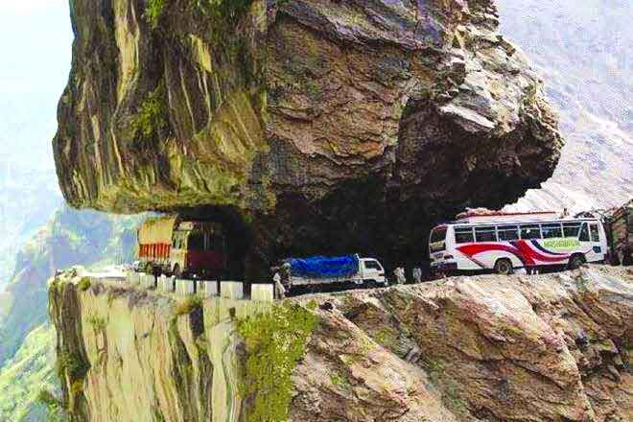
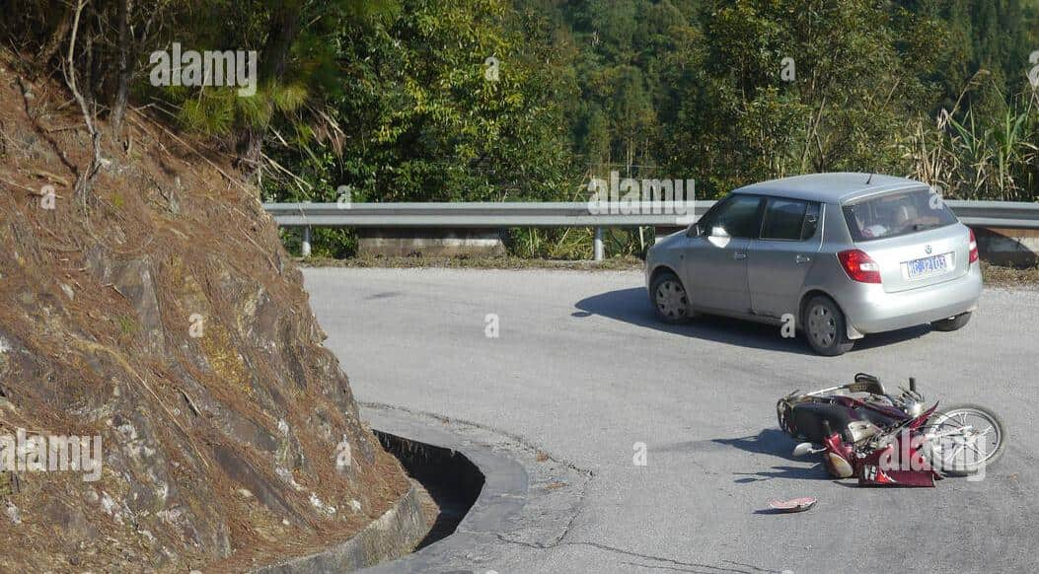
Real time scenario

Slide 12
Conclusion
To prevent road accidents in hilly areas, both drivers and authorities need to work together. Drivers should be careful, drive slowly, and pay attention to the road and weather. Roads should be kept in good condition, with clear signs, strong barriers, and good lighting. Teaching people about safe driving in hills is also very important. By being careful and prepared, we can make hilly roads much safer for everyone.

Slide 13


